Slide 1

Speak fluently
Intermediate

Slide 2
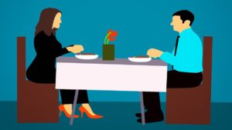
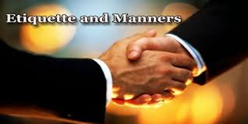
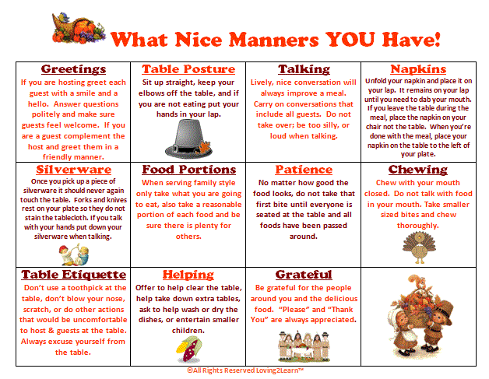
12. Etiquette and Manners

Slide 3
12. Etiquette and Manners
1- Is it old fashioned to think a lot about the rules of etiquette?
2) What rules of etiquette would you like to change?
What customs or social rules does our country have that a foreigner might not know?
3) White Lies: Is it okay to lie in order to avoid hurting someone’s feelings?
What examples of good manners do you often see?
What examples of bad manners do you often see?
What are some examples of bad manners on the bus?
What are some examples of good manners on the subway?
What are some examples of bad manners that you HATE?
Your company has designed a robot. Your job is now to program the robot to interact properly with humans. What instruction do you give the robot in the following areas?
- greeting people - driving a vehicle - international travel | - interacting with women (or men) - business etiquette - mobile phone usage | - eating at a restaurant - dating - writing e-mails - _______________ (other)

Slide 4
12. Etiquette and Manners
Do you think people are more polite or less polite now than in the past?
Can you think of some examples of how manners have changed in our country?
How are manners different in other countries?
How important is it to be polite to older people even though they are often rude?
Your aunt wants to add you as a ‘friend’ on Facebook. You don’t really want family invading your online social life. But, you know she’d be upset if you refused her request. What would you do in this case?
How do manners differ from country to country?
Are manners essential in business?

Slide 5
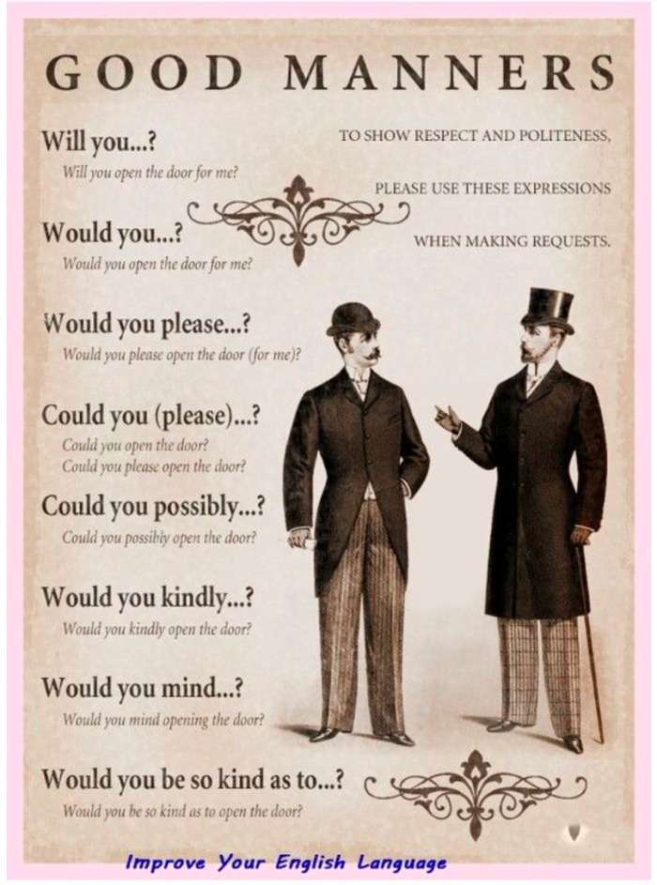
12. Etiquette and Manners
courteous
offensive
ladylike
gentlemanly
compliment
appropriate
swear
obliged
rude
punctual
slurping

Slide 6
12. Etiquette and Manners
Idiom | Meaning
mind your manners | be polite, be courteous, watch your P's and Q's
mind your own business | do not ask questions about my business
mind your P's and Q's | be polite, do not drink too much, mind your manners
mint condition | new condition, original condition, super mint
More Idioms:
A Bad Apple – Someone who has been brought up incorrectly and spoils a group
Put your foot in your mouth: to say something by accident that embarrasses or upsets someone

Slide 7
12. Etiquette and Manners
misery loves company | sad people want to be with other sad people | On the door of the jail was this sign: Misery Loves Company.
miss out on | not be there, be unable to attend | If I have a job, I'll miss out on the soccer games after school.
miss the boat | misjudge, misunderstand, make a mistake | I missed the boat on the essay question. My answer was wrong.
miss the point | not understand, not get the point | I missed the point of his remark. Do you know what he meant?
miss the water till... | (See you don't miss the water till the well runs dry)
miss you | feel lonely because you are not here

Slide 8
12. Etiquette and Manners
Most Used & Common Terms
Vocabulary | Explanation | Example
(Some) Change | Money exchange. | Have you got change to pay the swimming pool?
A banknote/a note/a bill | Paper money. | How many banknotes have you got?
A bargain | A good deal. | That’s a real bargain.
A bid | An offer in an auction. | What bids did you make?
A bill | An invoice. | I need the bill to be refunded.
A billboard | A large panel for advertising. | The billboards are huge.
A brand | A trademark. | Children love brands nowadays.
A carrier bag | A bag (usually plastic) supplied by shops. | Carrier bags are always provided.
A cashier | A person who operates cash register. | The cashier is so nice.
A catchphrase/a motto | A repeated phrase, slogan. | Do you know the brand’s catchphrase?

Slide 9
12. Etiquette and Manners
Most Used & Common Terms
Vocabulary | Explanation | Example
A charge/to charge | A fee/To ask for money. | How much do you charge for this?
A check/cheque | An order for bank to pay. | I usually pay the doctor by check.
A client/customer | Someone who buys products. | Clients should always be satisfied with what you sell.
A coin | Metal money. | How many coins have you got?
A consumer | Someone who consumes, who buys. | How many customers will you target?
A corner shop | A small, local shop that sells a little of everything – it needn’t be on a corner. | He loves shopping in the corner shop.
A cost/to cost | A price. | The cost of the product is too high.
A counter | A flat, elevated surface. | Meet me at the counter.
A coupon | A discount voucher. | We love using coupons when we shop.
A deal | A transaction. | They got such a good deal yesterday.
A delivery/to deliver | An act of delivering. | The delivery was done on time.
A department | A division of organization. | Which department do you work for?
A department store | A large store that sells a range of items in different departments such as food and clothing. | Department stores are heaven.

Slide 10
12. Etiquette and Manners
Most Used & Common Terms
Vocabulary | Explanation | Example
A design | A pattern, a styling. | He loves the new design of the product.
A discount store/pound shop | A shop where all the goods are sold at a discount. | My parents love going to discount stores.
A discount/to discount | A reduced price/to deduct from price. | They got a very good discount today.
A flea market | A market where antiques and second hand goods are sold. | It is so different to shop at the flea market.
A franchise | A business with a commercial licence. | Franchises are fun to shop in.
A fur trader | Person who deals in animal-fur products. | The fur trader did an excellent job with my coat.
A gift/present | Something you give to make the other person happy. | I love the gift he offered me.
A guarantee | A promise. | How long does the guarantee last?
A leaflet | A brochure. | Have you seen the company’s leaflet?
A loyalty card | a card issued by a shop to allow customers to save money on the basis of what they spend. | She has all the loyalty cards of her favorite shops.
A mall (US)/shopping centre (GB) | Place where many shops are gathered. | I love shopping in malls.
A market study | a study that analyzes market demand for a particular product or service. | Market studies are capital in advertising.
A must-have product | A product that is very popular that a lot of people want to have. | This bag is a must-have product.
A poll | A survey. | According to the poll, more and more clients shop there.
A purchase/To purchase | Something you buy/To buy. | What is this purchase I can see on your account?
A receipt | A proof of payment. | Did you get the receipt?

